Slide 1
KEYLOGGER PROJECT
PRESENTED BY:
P. SHIYAM
ANJALAI AMMAL MAHALIGAM ENGINEERING COLLEGE
INFORMATION TECHNOLOGY

Slide 2
OUTLINE
Problem Statement
Proposed System/Solution
System Development Approach
Algorithm & Deployment
Result (Output Image)
Conclusion
Future Scope
References

Slide 3
PROBLEM STATEMENT:
In today's digital age, where cybersecurity threats loom large, one of the significant concerns is the proliferation of key loggers, stealthy software tools designed to monitor and record keystrokes on a users computer without their knowledge. Key loggers pose a server threat to individuals and organizations as they can capture sensitive information such as passwords, credit card details, and other personal data, leading to identity theft, financial loss, and privacy breaches.

Slide 4
PROPOSED SOLUTION
Basic Keylogger:
Create a simple keylogger that captures all keystrokes (including special keys) and saves them to a log file. Use the pynput library to listen for key events. Save the captured keys to a text file(e.g., “log.txt”). Implement graceful exit (e.g, stop logging when the Escape key is passed)
Advanced Features:
Add timestamping to each logged keystroke. Encrypt the log file for security. Implement remote reporting (send logs to a server or email) for monitoring purposes.
Ethical Considerations:
Always use keyloggers responsibly and legally. Obtain proper consent before deploying a keylogger. Educate users about the purpose and scope of monitoring.
Encryption:
Consider encrypting the log file to protect sensitive information. Use encryption libraries (e.g., cryptography) to secure the log data. Encrypt the log content before writing it to the file and decrypt it when needed.
Remote Reporting:
Extend your keylogger to send logs remotely (e.g., via email or to a server).Implement a mechanism to periodically upload logs to a designated location. Ensure that the remote reporting feature is secure and follows privacy guidelines.

Slide 5
SYSTEM APPROACH
Purpose of a Keylogger:
A keylogger is a software tool designed to record keystrokes made by a user on a computer keyboard. It serves various purposes
Security Auditing: Organizations use keyloggers to monitor employee activity and detect unauthorized actions.
Parental Control: Parents can use keyloggers to track their children’s online activities
Types of Keyloggers:
Hardware Keyloggers: These are physical devices connected between the keyboard and the computer. They intercept keystrokes and store them in internal memory.
Software Keyloggers:
Kernel-based Keyloggers: Run at the kernel level, allowing them to capture keystrokes before they reach the operating system
Methods of Keylogging:
Keyboard Hooks: Register hooks to intercept keystrokes.
Mouse Hooks: Capture mouse events.

Slide 6
ALGORITHM & DEPLOYMENT
Algorithm:
An algorithm is a step-by-step procedure or set of rules for solving a specific problem or performing a task.
It serves as the blueprint for creating software, guiding the computer through a series of logical operations.
Key considerations for designing algorithms include efficiency, correctness, and scalability.
Common algorithmic paradigms include greedy algorithms, divide and conquer, dynamic programming, and more.
Deployment:
Deployment refers to the process of making software available for use by end-users.
It involves several stages:
Build and Compilation: Transforming source code into executable binaries.
Configuration: Setting up environment variables, database connections, and other parameters.
Testing: Ensuring the software works as expected in different environments.
Release Management: Managing different versions (e.g., alpha, beta, production).
Installation: Distributing and installing the software on target machines.
Monitoring and Maintenance: Monitoring performance, handling updates, and addressing issues.

Slide 7

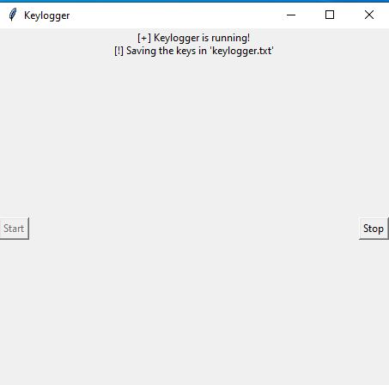

RESULT:
The keylogger runs and saves all keyloges to “c:\output.txt”
To Start Keylogger
Keylogger Running
Keylogger Terminated

Slide 8
CONCLUSION:
Keyloggers are powerful tools that can serve both legitimate and malicious purposes. While they have practical applications in monitoring employee activity or troubleshooting technical issues, their misuse can lead to serious privacy breaches. As users, we must remain vigilant by using antivirus software, avoiding suspicious downloads, and practicing safe online habits. By understanding keyloggers, we empower ourselves to protect our sensitive information and maintain digital security.

Slide 9
FUTURE SCOPE
Enhanced Detection Techniques:
Explore advanced methods for detecting keyloggers beyond traditional antivirus software. Investigate behavior-based detection, anomaly detection, and machine learning approaches. Consider integrating threat intelligence feeds to identify new and emerging keyloggers
Real-time Alerts and Response:
Implement real-time alerts when suspicious keystrokes are detected. Design mechanisms to notify users or administrators immediately upon keylogger detection. Consider automated responses, such as disabling affected accounts or blocking malicious processes.
User Education and Awareness:
Educate users about the risks of keyloggers and safe practices. Provide guidelines on avoiding suspicious downloads, using virtual keyboards, and maintaining strong passwords.
Privacy Protection:
Explore encryption techniques to protect captured keystrokes during transmission. Implement secure storage mechanisms for log files. Consider user consent and privacy implications .Remember that ethical considerations are crucial when developing and deploying keyloggers. Always prioritize user privacy and security.

Slide 10
REFERENCES
Keylogger Detection and Prevention:
Keyloggers are a type of rootkit malware that capture typed keystrokes from the keyboard and save them into a log file.
They can capture sensitive information such as usernames, PINs, and passwords without alerting users.
Keyloggers pose a significant threat to various activities, including e-commerce, internet banking, and email communication. While antivirus software can detect and remove known keyloggers, it struggles with identifying unknown ones.
Project Report on Keyloggers:
Keyloggers record keystrokes on a keyboard, often covertly.
Software-based keyloggers are detected based on behavioral patterns and do not grant root privileges.
Detection relies on permission from the kernel and is susceptible to attacks.
Understanding Keystroke Logging:
Keystroke logging (keylogging) involves recording keyboard input.
It plays a role in cybersecurity threats and can be used maliciously.

Slide 11


